Slide 1
Helmet Detection on Motorcyclists Using Image Descriptors and
Classifiers
Authors:
Romuere R.V.e Silva , Kelson R. T. Aires and Rodrigo de M. S. Veras
Ishika Gupta

Slide 2


TABLE OF CONTENT
01
INTRODUCTON
02
PROPOSED METHODOLOGY
03
VEHICLE SEGMENTATION AND CLASSIFICATION
04
DETECTION OF HELMET
05
RESULT
06
CONCLUSION

Slide 3
INTRODUCTION
Due to the large number of vehicles in circulation, the number of
accidents involving motorcycles has increased during the last years.
Therefore studies of intelligent traffic systems have increased.
This paper proposed a method for motorcycle detection and classification and a system for the detection of motorcyclists without helmets.
The majority of studies focus on the detection, recognition, tracking and counting of vehicles and on the estimation of traffic parameters

Slide 4
Proposed Methodology
This study proposed a computational vision methodology for the detection of helmet use by motorcyclists on public roads.
The study is divided into two stages:
Vehicle segmentation and classification
Detection of helmet use
The stage of vehicle segmentation and classification has the following objectives: determining which objects are moving in the scene and classifying these objects

Slide 5
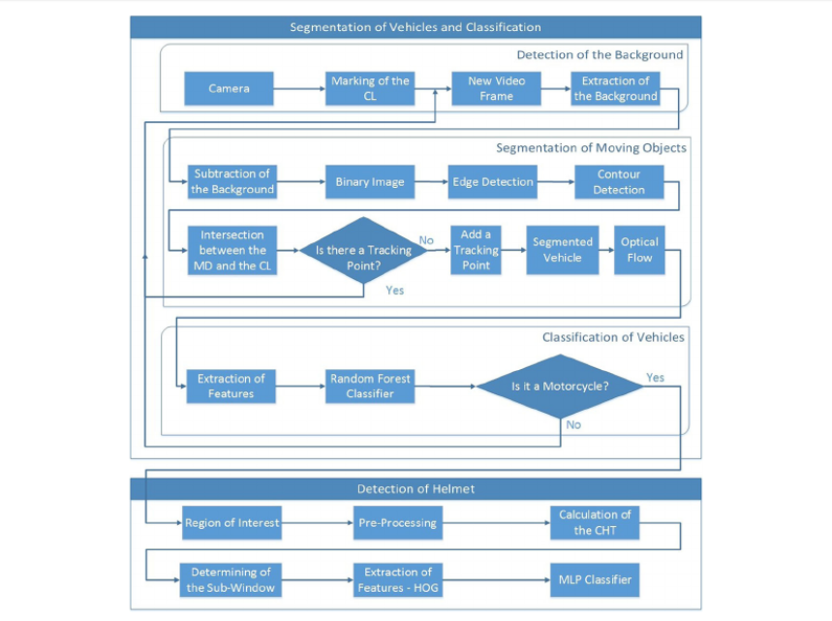
1. Vehicle segmentation and classification
Flow Diagram of all steps of the
proposed system, where MD is the main diagonal, CL is the cross
line, WT is the wavelet transform, CHT is the circular Hough transform, HOG is the histogram of oriented gradient descriptor and MLP is
the multilayer perceptron
classifier

Slide 6
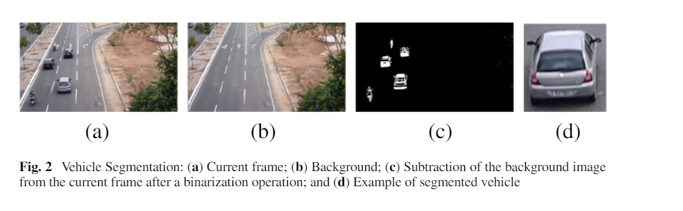
The stage of vehicle segmentation and classification comprises three stages:
detection of the background, segmentation of moving objects and
vehicle classification
Detection of the Background: The main objective of this step is to obtain an image that will be used to detect moving objects. The calculation of the background
image was performed using the AGMM algorithm

Slide 7
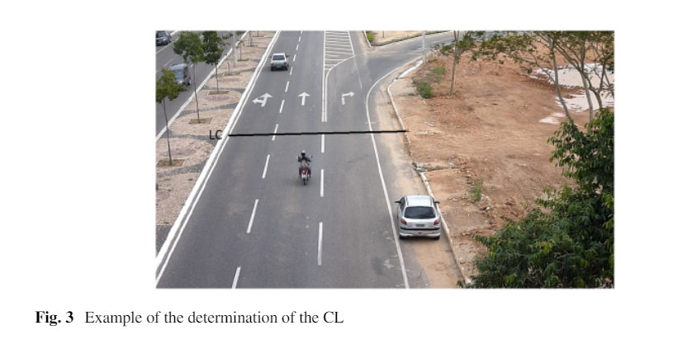
2. Segmentation of moving objects:
The segmentation of moving objects on the scene facilitates the evaluation of the objects of interest in the image. The method of background subtraction receives all points that
were altered in a scene as shown in the figure.
For the segmentation of moving objects in the proposed system, a CL (Fig. 3), which is
marked by the user in the calibration stage of the system, must be defined

Slide 8
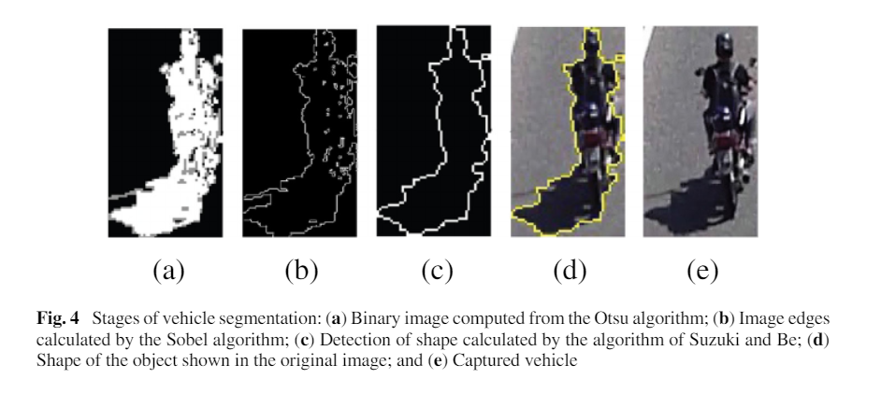
3. Vehicle Classification:
The task of classifying the vehicles consists of
differentiating the segmented objects into two class:
motorcycles and non-motorcycles
The features of the images are extracted using
the WT and the image that was segmented
in the previous stage
A feature vector is obtained for each
generated image. This vector is used by the random forest classifier to determine which class the
vehicle is associated.
The images were resized to obtain a single size for all images. The best result was obtained for images with 50 ×200 pixels.
The random forest was tested with 10, 20, 40, 80 and 100 trees. The best result was obtained with 80 trees.

Slide 9
2. Detection of Helmet
The stage of detection of helmet use by motorcyclists was divided into three main stages:
determining the RoI, extraction of the attributes and image classification.
Determining of RoI:
The use of this region enables the reduction of the area in which the search will be performed, which implies less processing time and a greater precision of the results compared with the complete image.
Extraction of Features:
Pre-processing is performed to obtain a sub-window that corresponds to the head region of the motorcyclist.
Steps:
a grayscale image was calculated
an average filter with a 5 ×5 neighbor-hood was applied to reduce the noise of the image
the Otsu threshold is calculated
This threshold is applied to the grayscale image to obtain a binary image (black and white)
last step is the application of the Sobel algorithm to the binary image, which results in the image edges
Image Classification:
The image classification task consists of differentiating the segmented objects into two classes: with helmet and without helmet. The MLP classifier was employed in this stage

Slide 10
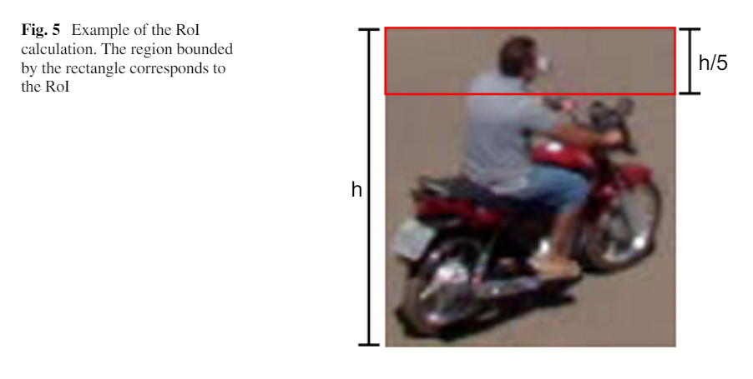
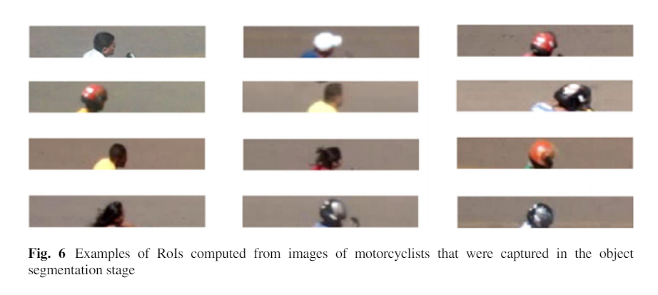
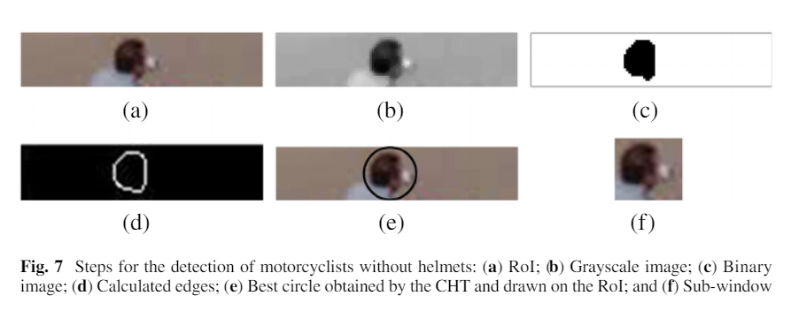
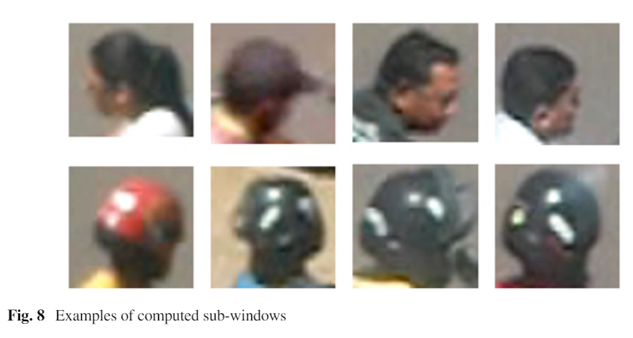
How to detect HELMET?
STEP 1
STEP 2
STEP 4
STEP 3

Slide 11
RESULT
The results are divided into two groups:
results of the vehicle classifier
results of the helmet detector
Two image database obtained: database1 and database2
The first database was employed in the classification of the vehicles, and the
second database was employed in the detection of the helmets.
The videos have a resolution of 1280 ×720 pixels and 30 frames/s. The total duration of all videos is 150 minutes
Database1 was obtained from 110 minutes of video and is composed of a total of 3,245images, which are divided as follows:
2,576 images of non-motorcycles
669 images of motorcycles.
Database2 was obtained from 40 minutes of video. Database2 is distributed as follows
151 images of motorcyclists with helmets
104 images of motorcyclists without helmets

Slide 12
Methods of evaluation of results:
The confusion matrix is a table that shows the classification results. The matrix is com-posed of four values: true positive (TP), false positive (FP), false negative (FN) and true negative (TN) and then Kappa coefficient (K) are calculated
Another result evaluation method involves Receiver Operating Characteristic (ROC) curves. The ROC curves show the true positive rates versus the false positive rates. The main information that is extracted from a ROC curve is the area under the curve (AUC); the larger the area is the better the classifier.
In addition to the WT and the random forest classifier, the HOG, local binary pattern(LBP) and Speeded Up Robust Features (SURF) descriptors and the SVM, radial basis function neural network (RBFN), MLP and naive Bayes
classifiers were also tested.
RESULT FOR VEHICLE CLASSIFICATION:
From the results obtained for the SVM classifier. The classifier obtained a maximum hit rate of 0.9763 using the LBP
descriptor. The results were similar to the results of the proposed system, which was 0.9778.
Similar results were obtained for the Kappa coefficient, which also obtained “Excellent” results (0.9272).
The best result for this classifier was 0.9676 with the SURF descriptor, and the worst result was 0.9510 with the
HOG descriptor.

Slide 13
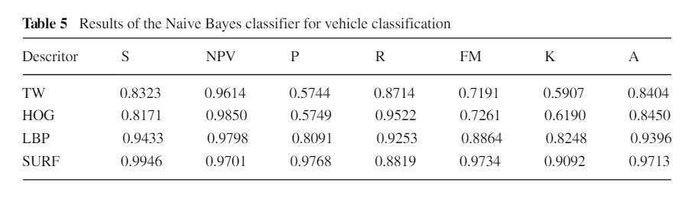
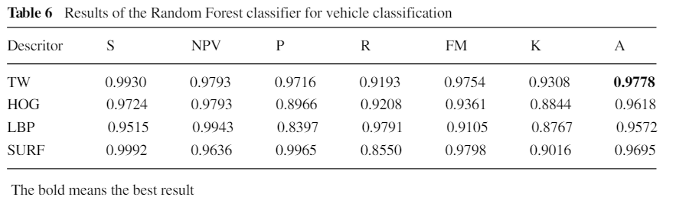
The results of the naive Bayes classifier .This classifier obtained an accuracy of 0.9713 with the SURF descriptor and a specificity of 0.9946; this rate indicates that almost all objects of the non-motorcycle class were correctly classified.
RESULT FOR HELMET DETECTION:
The obtained result was an accuracy of 0.9137. From a total of 255 images, 22 images were incorrectly classified.

Slide 14
CONCLUSIONS
In the stage of vehicle segmentation and classification, algorithms for the
background calculation and tracking of objects, descriptors and classifiers that
exhibited reasonable hit rates and low processing times were selected from the
literature achieving an accuracy of 0.9778.
In the stage of detection of helmet use, algorithms for the extraction of features in
images and classification algorithms were employed. The proposed system also
obtained satisfactory hit rates. The MLP classifier that incorporated the HOG
descriptor obtained the best results, with an accuracy of 0.9137.

Slide 15
THANK YOU

